Slide 1
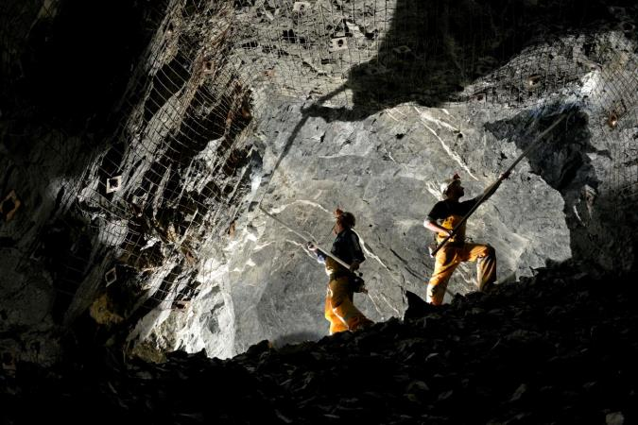
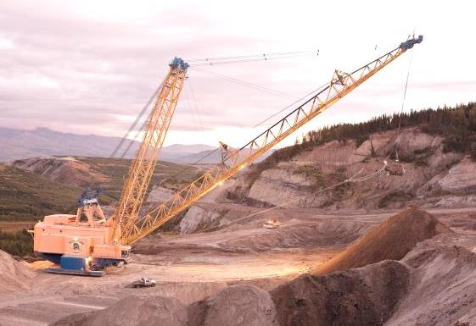
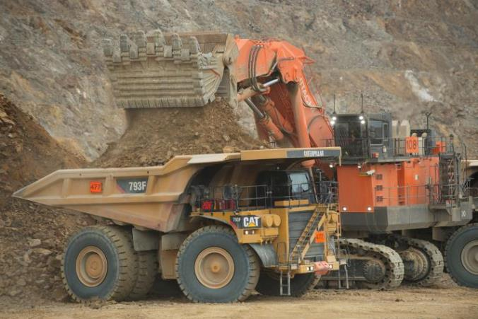
Mining Industry Update
House Resources Committee
April 8, 2019

Slide 2
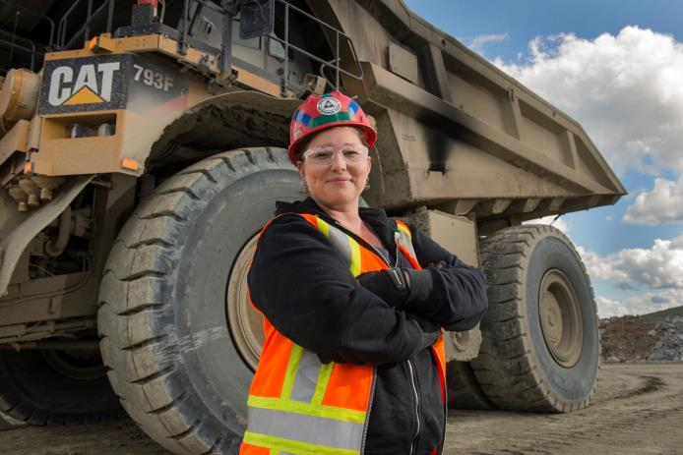
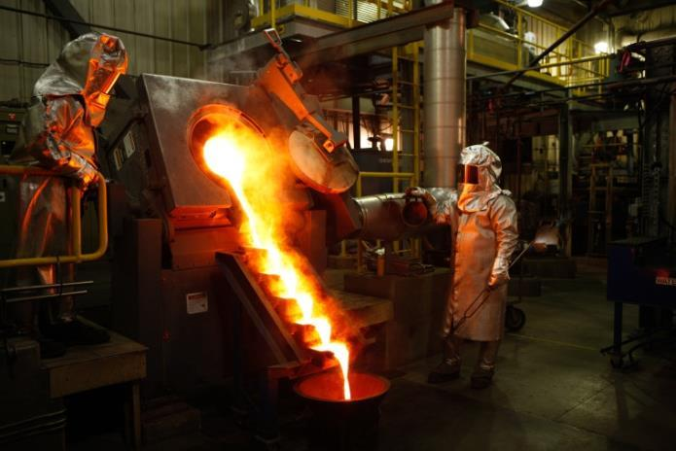
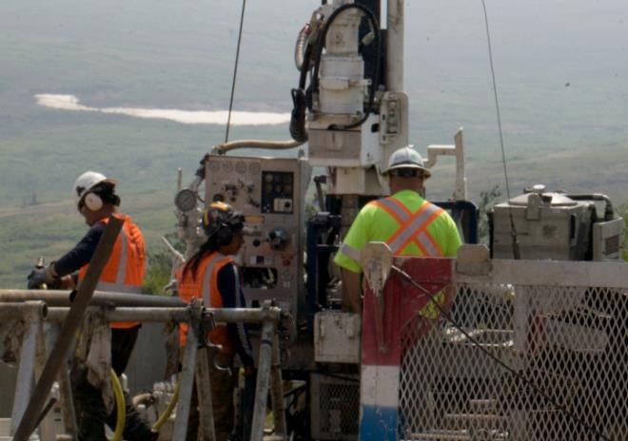
Why do we mine?
Where do we mine?
Doing it right: environmental safeguards
Benefits for Alaska and Alaskans
Mining pays its way

Slide 3
Why do we mine?
If you have turned on a light, entered a building, driven on a road, made a phone call, used a computer, or visited a doctor, then mining is an important part of your life.

Slide 4
335 tons steel
molybdenum
700 lbs rare earths
3 tons aluminum
zinc
4.7 tons copper
Notes:
Minerals and metals underpin the renewable energy economy
Rechargeable batteries, solar panels, catalytic converters all need minerals.
Hybrid cars require almost twice as much copper as regular vehicles.

Slide 5
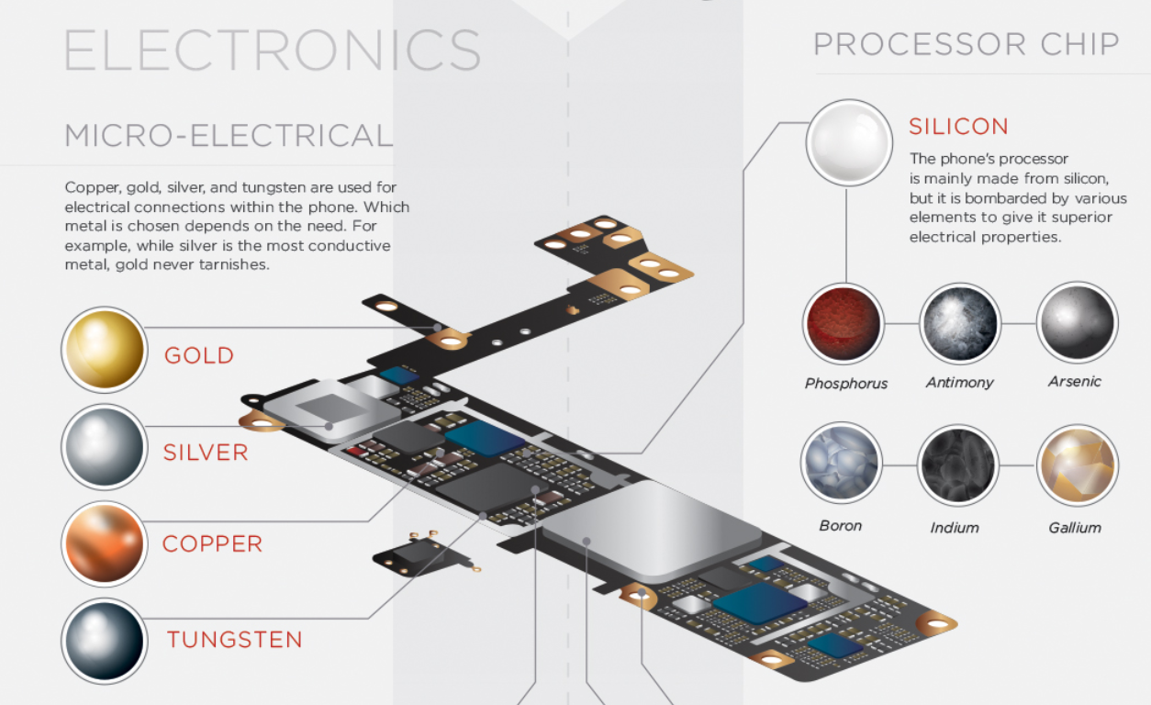
Alaska metals could be in your phone
www.visualcapitalist.com

Slide 6
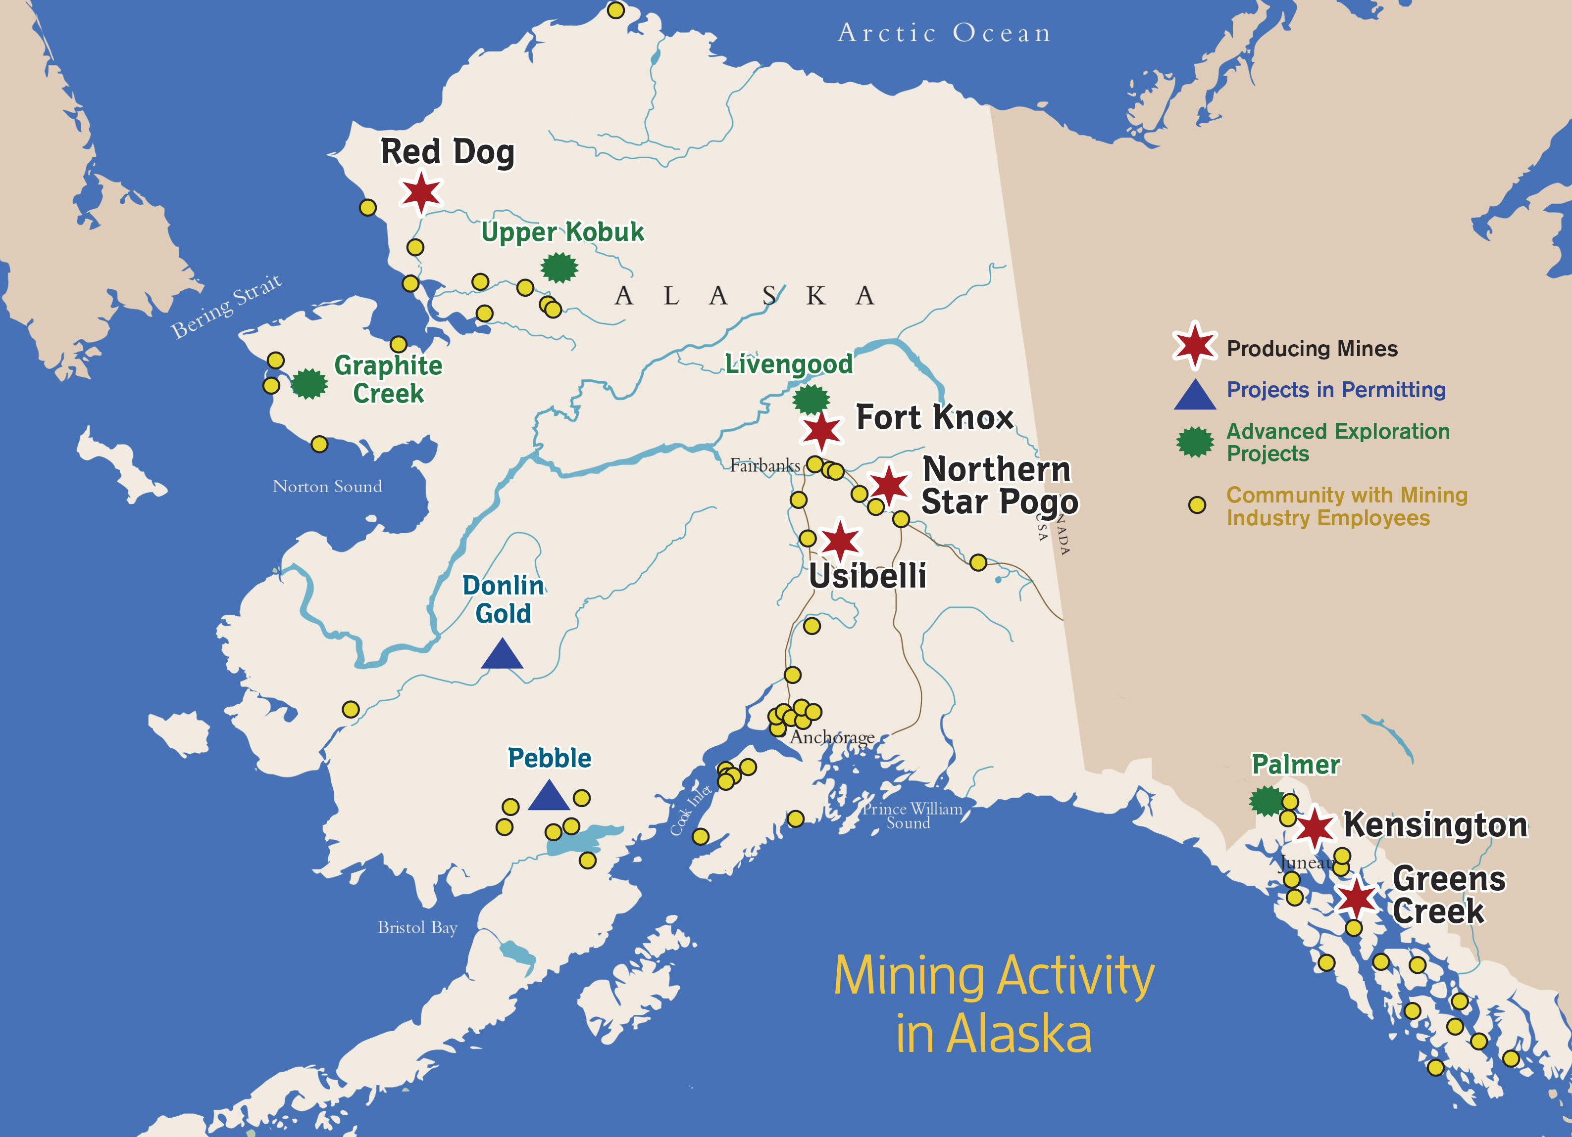

Slide 7
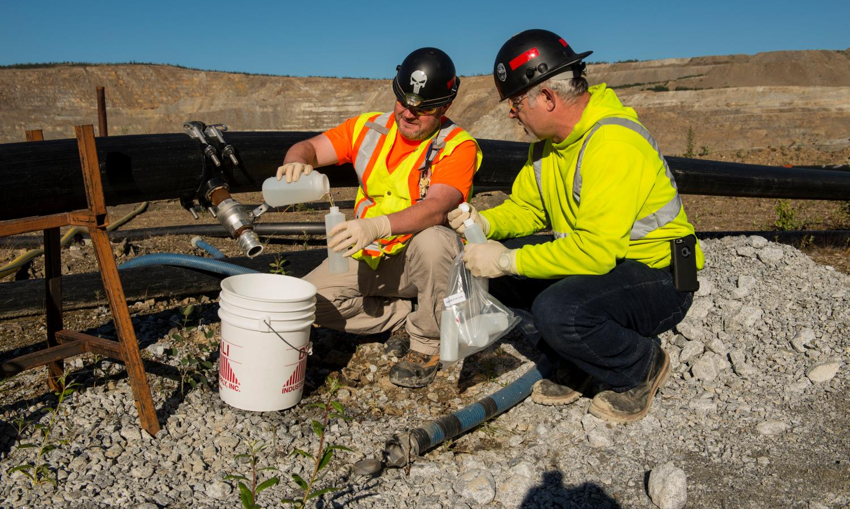
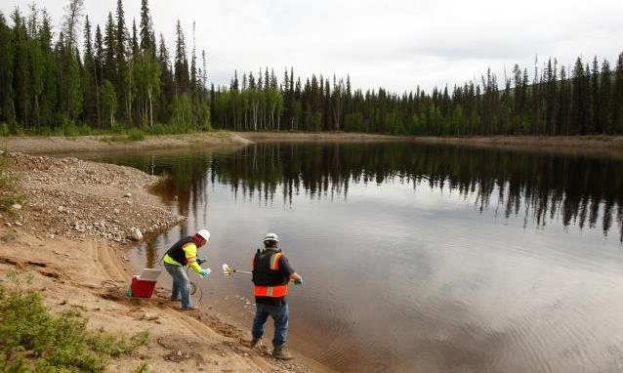
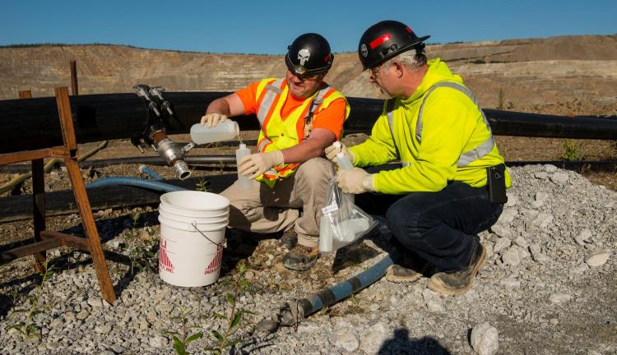
Doing it Right: Environmental Safeguards Alaska’s World Class Regulatory System
Rigorous permitting regulations protect air, water, fish, wildlife, and human health
Strict agency oversight during operation
Closure/reclamation requirements
Financial assurance
Notes:
(young metal industry, built under NEPA, CWA
High expectations about safety and environmental protection
Now that we have discussed the benefits of mining in Alaska and the potential to multiply the operations and those benefits, we’d like to finish by providing some detailed information about the environmental regulatory regime under which mines in our state operate.
Certainly for your Committees, but also in the public sphere there is conversation associated with impacts to the environment from mining. Miscellaneous policy proposals and heightened advocacy seem to call into question whether mines are adequately regulated and if the environment is adequately protected.
The answers to those questions is yes. We fundamentally believe that Alaska has a world class regulatory system.
Our mines are permitted for the protection of air, land, water, and fish and wildlife, and there is strict regulatory oversight throughout the mine life.
That oversight doesn’t end when the mine closes. There is extensive planning and continued oversight of the mine closure and reclamation work to restore the site.
and there is tailored financial assurance, if for some reason the state needs to step in, the money is there to cover the State’s costs.

Slide 8
No Single Permit to Mine: there are many permits & authorizations
Mine permitting is a mixture of State, Federal and local permitting requirements.
Each project is unique.
STATE
Plan of Operations (DNR)
Reclamation and Bonding (DNR)
Waste Management Permits and Bonding (ADEC)
CWA Section 402 APDES Water Discharge Permit
Certification of ACOE Permits (ADEC)
Sewage Treatment System Approval (ADEC)
Air Quality Permits (ADEC)
Fish Habitat and Fishway Permits (ADF&G)
Water Rights (DNR)
Right of Way/Access (DNR/DOT)
Tidelands Leases (DNR)
Dam Safety Certification (DNR)
Cultural Resource Protection (DNR)
Monitoring Plan (Surface/Groundwater/Wildlife) (DNR/DEC/DFG)
FEDERAL
US EPA Air Quality Permit review
US EPA Safe Drinking Water Act (UIC Permit)
US ACOE S. 404 Dredge and Fill Permit
US ACOE S. 10 Rivers and Harbors Act
US ACOE S. 106 Historical & Cultural Resources Protection
NMFS Threatened & Endangered Species Act Consultation
NMFS Marine Mammal Protection Act
NMFS Essential Fish Habitat
NMFS Fish and Wildlife Coordination Act
USFWS Threatened & Endangered Species Act Consultation
USFWS Bald Eagle Protection Act Clearance
USFWS Migratory Bird Protection
USFWS Fish & Wildlife Coordination Act
These are only some of the permits required!
Notes:
Mining has made great strides in the last fifty years.
The planning and environmental review, testing, and approval process to permit a large mine in Alaska take many years from start to finish, with dozens of local, state and federal government agencies involved in that process.
One of the most important things to understand about that process is that it does not guarantee approval.
Every mine is different and requires a tailor-made plan for environmental mitigation.
And there are opportunities throughout the process for public participation.
A look at permitting a mine. This slide is actually a Department of Natural Resources slide which displays just some of the permits required to mine in Alaska.
The planning and environmental study, review, testing, and approval process to permit a large mine in Alaska takes many years from start to finish, with dozens of local, state and federal government agencies involved in that process.
The permits listed here are what is typical for a mine on State or Privately owned land – still, with a large amount of federal authorizations required. A mine permitted on federally owned land brings many additional permits, such as those held under the Bureau of Land Management and the US Forest Service’s mining regulations.
Permits contain multiple stipulations in addition to compliance with statutes and regulations - what this means is, agencies can and they do prescribe additional practices to be performed by the mine that are outside of or in addition to the governing laws.
One of the most important things to understand about the mining permitting process is that it does not guarantee approval. There is no automatic yes. Every mine is different and requires a tailor-made plan for environmental mitigation that is discussed and altered at length by both the permitting agencies and the developer.
It is equally important is that continuously throughout this process, there are multiple opportunities for public participation.

Slide 9
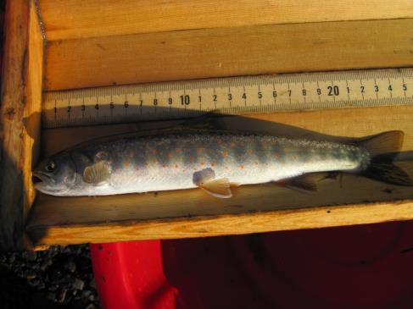
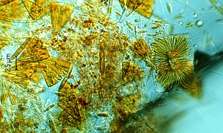
Alaska’s Permit System is Unique
State agency implementation of stringent water quality standards
Robust monitoring system; including biomonitoring
Third party compliance audits of both:
company methodology and results
regulatory agency oversight
Notes:
Alaska one has the best water quality monitoring systems in the world with respect to mines. It has three distinct parts:
First, we do Water quality monitoring, which is fairly standard.
And in Alaska, we take a further step, which is fairly uncommon in other jurisdictions, and do Biomonitoring. Our Department of Fish and Game oversees monitoring of:
a) Algae
b) Benthic Environment
c) Fish, including metals uptake, habitat, and population.
**phytoplankton/aquatic insects/fish measurements
And the third part is: Alaska requires a 3rd-party audit, which is a transparent public process that monitors not only the company's compliance but also the state agencies that oversee the company’s reports and results.
I don’t know any place which does all three of these things and in this great of detail. Alaska does more and better monitoring than most of the world, and it is certainly a system we can all be proud of.

Slide 10
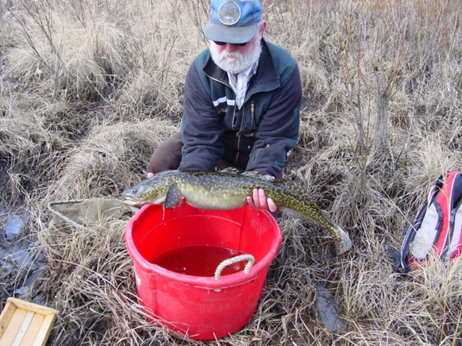
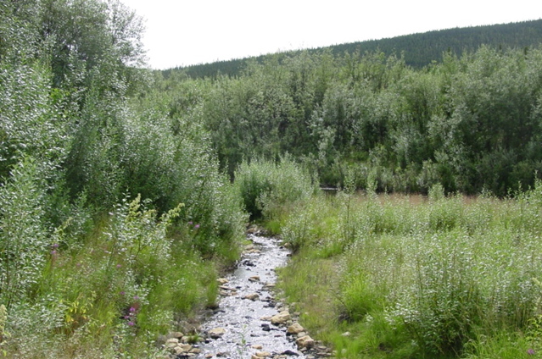
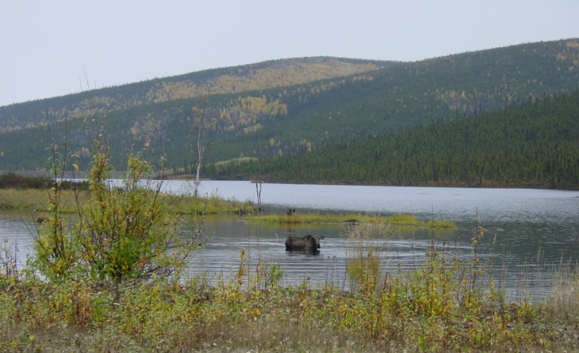
Doing it Right: Fort Knox Mine
Notes:
**add in additional information from Anna and April magazine here**
At the Fort Knox Mine, historic placer mining in the neighboring vicinity had left a landscape of exposed permafrost and isolated ponds. Although it was not an area the Fort Knox Mine had operated in, they joined with the Alaska Department of Fish and Game to rehabilitate the area. They constructed stream channels to connect the ponds, which you can see in the upper right photo, which provided for fish passage between the ponds. In addition, the activity diversified the vegetation from the mainly black spruce you can see on the hillsides with the addition of shrubs and willows, which as you can see, the moose love. The area resulted in a fish and wildlife sanctuary, with prize-sized fish that can see be seen in the photo of the ADF&G employee in the top left. At the time of performing this restoration, the agency targeted to reach the goal of fish size and quantity after mine closure. They reached it in two years. ADF&G and Fort Knox jointly received environmental awards for their work.
I mentioned that some agencies prescribe additional stipulations outside of the regulatory permits, and in some cases mines go above and beyond their requirements to perform environmental enhancement that deserves our recognition.
At the Fort Knox Mine, historic placer mining from the early 1900s, in the neighboring vicinity had left a landscape of isolated gravel ponds and exposed permafrost. Although it was not an area the Fort Knox had operated in, they joined with the Department of Fish and Game to rehabilitate the area.
They constructed stream channels to connect the ponds, which you can see in the upper right photo, which provided for fish passage between the ponds. The activity diversified the vegetation from the mainly black spruce you can see on the hillsides with the addition of shrubs and willows, which as you can see, the moose love. The area resulted in a fish and wildlife sanctuary, with prize-sized fish that can see be seen in the photo of the ADF&G employee in the top left.
At the time of performing this restoration, the agency targeted to reach the goal of fish size and quantity after mine closure. They reached it in two years. ADF&G and Fort Knox jointly received environmental awards for their work.

Slide 11
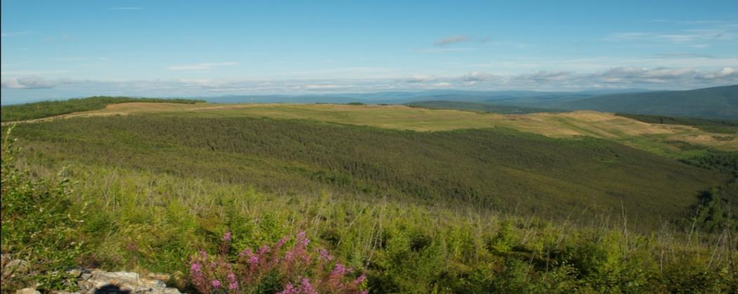
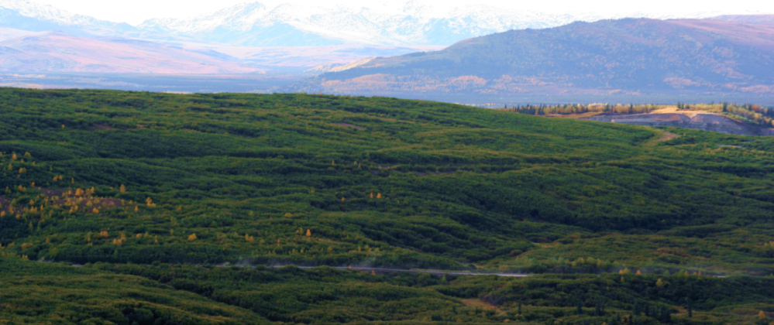
Reclamation and Closure
True North (Fairbanks)
Poker Flats (Healy)
Alaska law (AS 27.19) requires that a mine site must be returned to a stable condition compatible with the post-mining land use
Plan must be approved by DNR Commissioner before operations begin
Financial assurance applies to all companies
Reviewed every 5 years or earlier if necessary
Notes:
Strict regulatory oversight doesn’t stop when the mine gets permitted, nor throughout operations, and continues through reclamation and closure.
Again, mines are under strict regulatory oversight throughout permitting and operation, but that doesn’t stop when the mine shuts down. In fact, the mine’s plan for reclamation and closure, as mandated by law, must be approved by the DNR Commissioner before operations begin.
In addition to being required to obtain approval of the reclamation plan, mines must provide financial assurance in the event reclamation obligations cannot be performed, and that financial assurance amount is also required to be approved before operations begin.
Financial assurance requirements apply to all companies, regardless of where they are headquartered, and all mines, regardless of land ownership. Financial assurance guarantees are reviewed every five years, or earlier if necessary, a system that is again unique to Alaska. Third party reviewers evaluate not only the operation and reclamation plan, but also the oversight of the state and federal agency regulating the operation and reclamation. This is another area where we shine, as Alaska is the only state that does this.

Slide 12
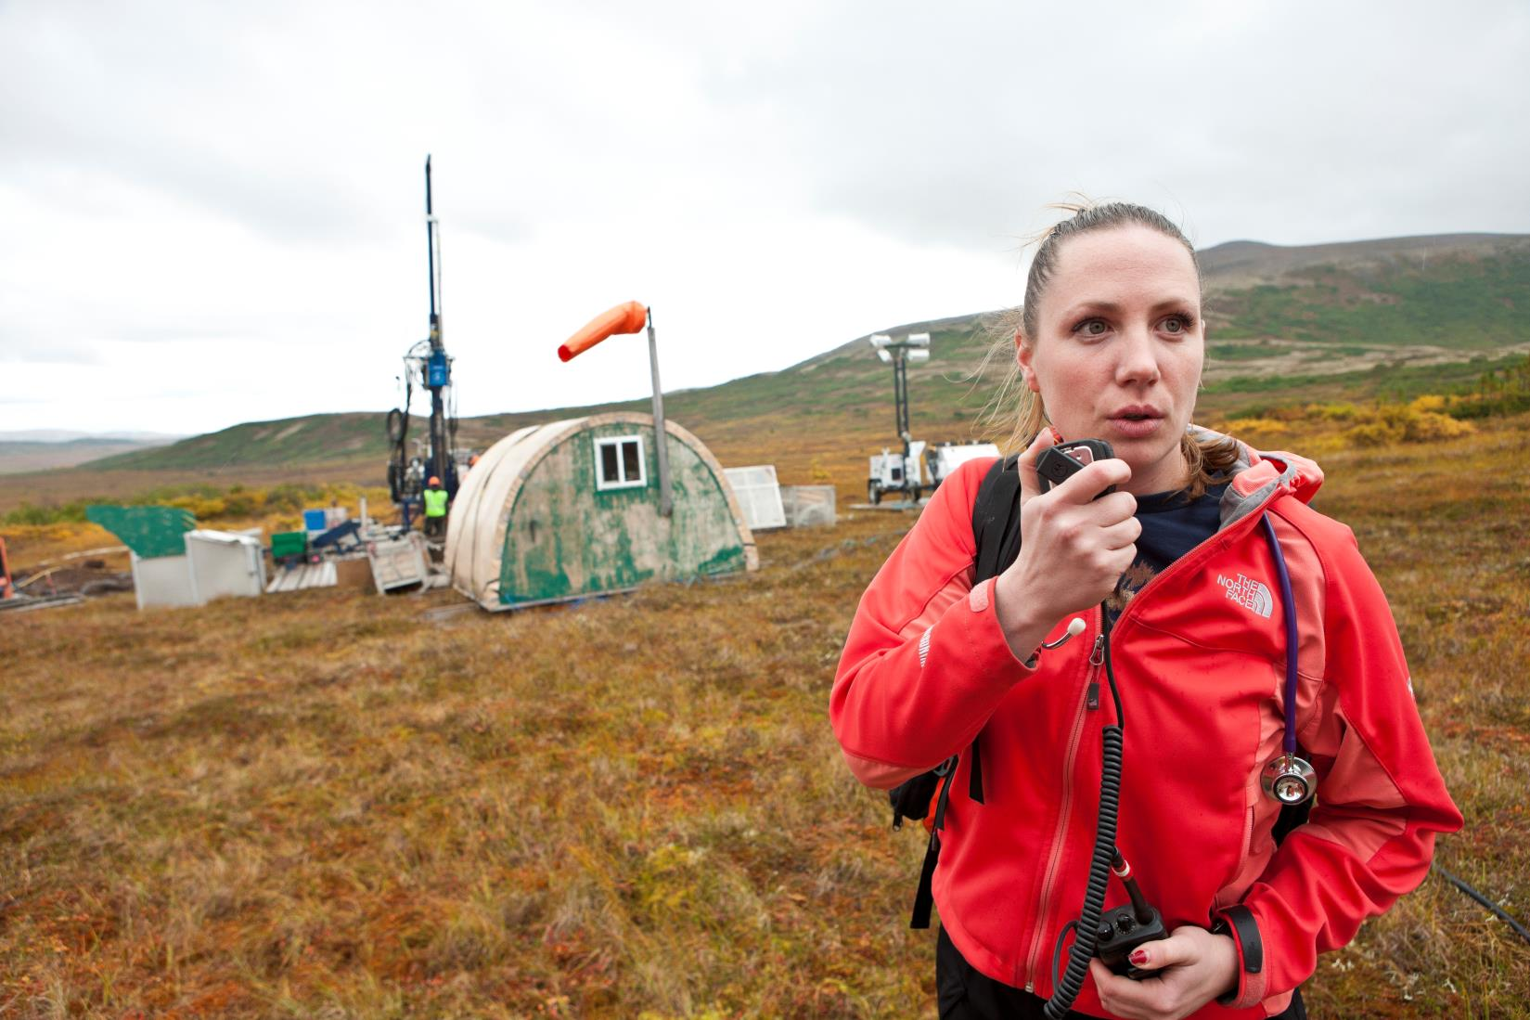
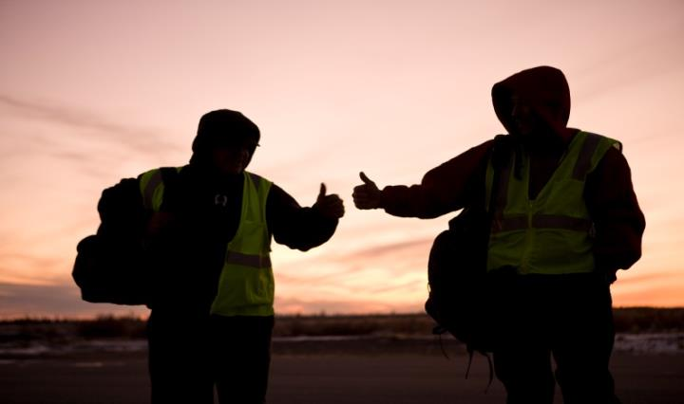
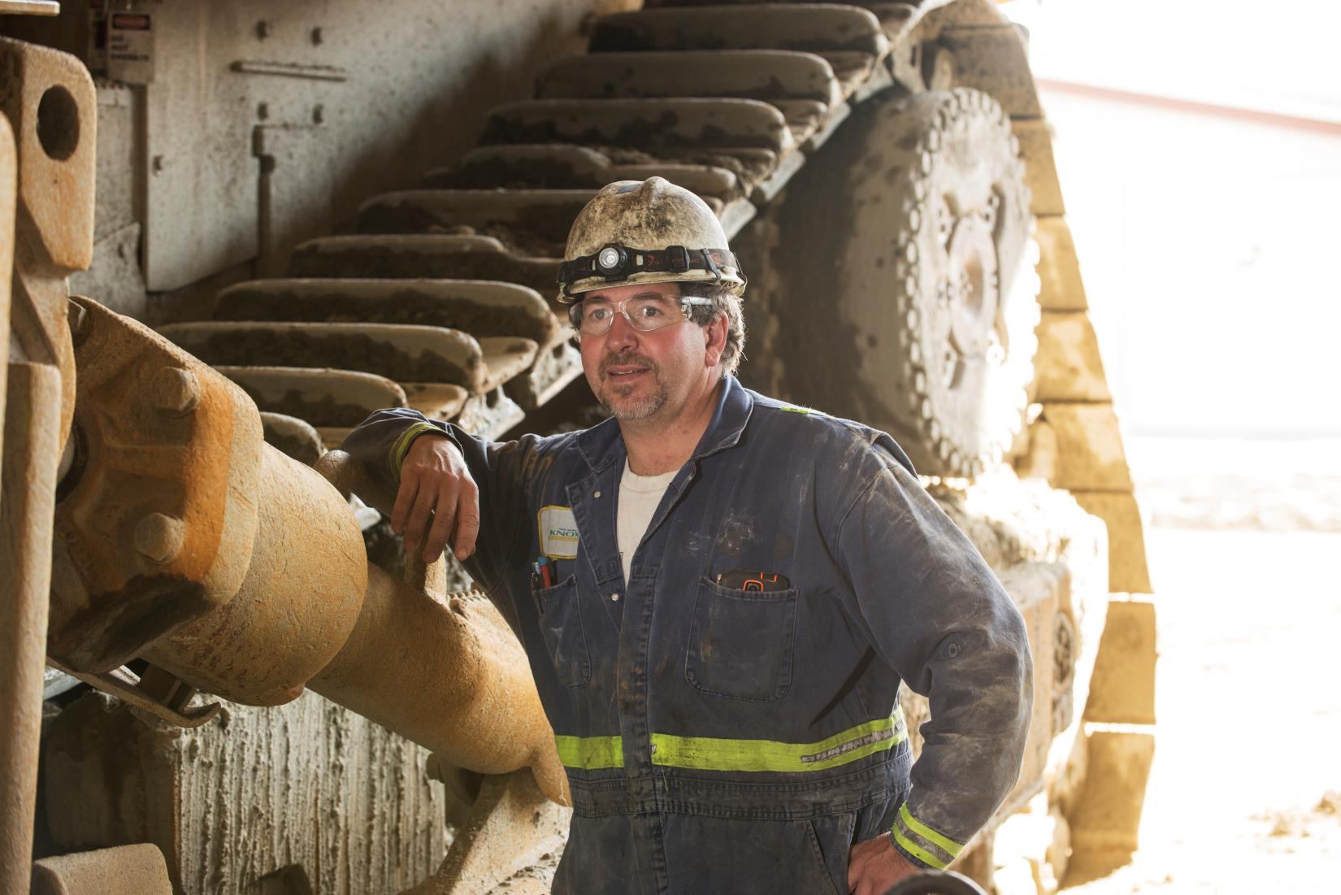
Benefits to Alaska: jobs
4,500 direct jobs
9,200 total direct and indirect jobs
$715 million total payroll
Average annual wage of $102,000
Residents of 60+ communities
Contracts for AK businesses
Notes:
Deantha outlined why we need minerals as well as the measures in place to ensure that mining is safe and responsible in AK, now let’s look at what mining contributes to AK and to Alaskans.
Mining companies directly employ more than 4,000 people and provide thousands more good jobs to people working for companies who provide services to Alaska mines, in transportation, engineering, environmental management, camp services, etc. . These are good jobs. Mostly year-round, paying an average of $108K/year, almost twice the average salary in AK. The majority of these workers live all over the state, many in rural areas. The main point I hope you take away from this slide is that mining has a strong, positive regional impact.

Slide 13
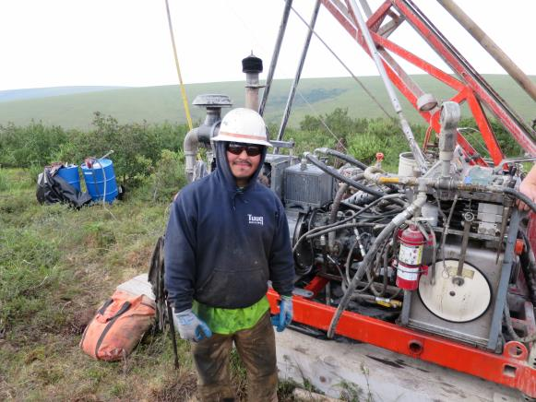
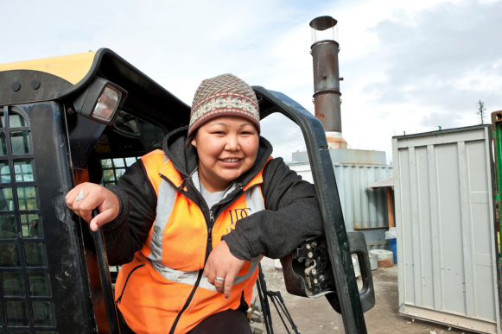
Benefits to Alaska Native Corporations
7(i) and 7(j) royalty sharing:
$1.9 billion to NANA (1982-2018), of which $1.2 billion shared
Jobs for shareholders:
Red Dog 55%
Upper Kobuk Minerals Projects 58%
Business partnerships
Notes:
There is a lot of data here, a lot of good data, but this slide doesn’t do justice to the positive impact of mining in partnership with Native Corporations. In the 1980s, NANA negotiated an innovative agreement for Red Dog, ensuring that the region would benefit not only from the royalties, but also jobs for shareholders and contracting opportunities for NANA companies. And through the royalty sharing provisions of ANCSA, hundreds of millions of dollars have been shared with all the ANCSA corporations in AK. Today, there are more than 600 jobs at Red Dog and 58% of them are filled by NANA shareholders. Red Dog has been operating since 1989 and there are some third generation employees there.
Another great example is the DonlinGold project. During their exploration phase, their local hire rate was more than 90%. Part of the Donlin project plan is a 315 mile gas pipeline to bring energy to the mine. This could include access for local villages, providing a clean and affordable fuel source in a part of the state where the cost of energy is too high. These are just two examples of mining being an economic engine in rural AK.

Slide 14
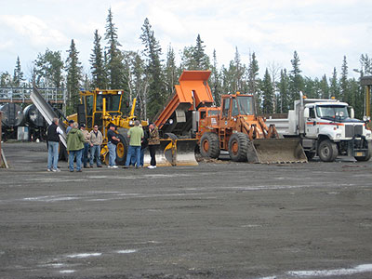
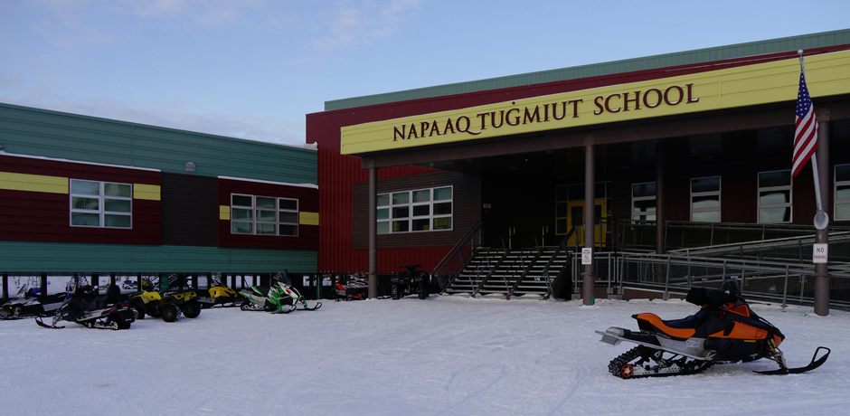
Local and State Government Revenue
2018
$34 million to local governments (largest taxpayers in Juneau, Fairbanks and Northwest Arctic)
$103 million to state government
$46 million in other state government-related revenue
Notes:
Benefits to local and state governments.
$23 million to local governments. Mines are the highest property taxpayers here in the C and B of Juneau, the Fairbanks North Star Borough and the Northwest Arctic Borough. Mining taxes and community contributions are also important in Healy, Delta Junction and Nome.
At the state level, mining companies pay an industry-specific tax, the AMLT, as well as corporate tax. Mines on state lands also pay rents and royalties to the state government. I’ll look at state revenue in more detail in the next slides.

Slide 15
State Revenue vs. State Costs
State Revenue Local Revenue Operations Capital
“Fiscal Effects of Commercial Fishing, Mining, & Tourism. What does Alaska receive in revenue? What does it spend?”
Bob Loeffler and Steve Colt, Institute of Social and Economic Research, UAA, 2016

Slide 16
Alaska Mining Revenue

Slide 17
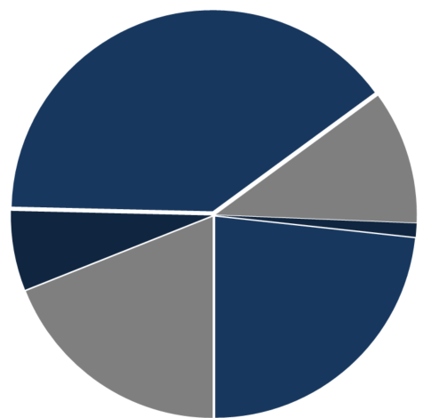
State Revenue 2018:
$148.6 Million
MLT, rent, royalties
$58.8
AK Railroad
$15.9
Mental Health Trust $1.6
State misc.
$9.5
Corp. tax
$34.6
AIDEA
$28.2
Figures in millions of dollars

Slide 18
Sources
2011-2017: ADNR Alaska Mineral Industry report 2017
2018: ADOR presentation 4/8/2019
Notes:
Commodity Prices Impact Revenue

Slide 19
Alaska State and Federal Taxes
Does not include local property taxes/PILT and local sales taxes
Royalty
AMLT
State
Federal

Slide 20
Land status determines
rents and royalties
Currently only one of the five metal mines operates exclusively on state lands.
Notes:
As I mentioned before, we shouldn’t look at the payments to the state in isolation because the total is what matters to the company’s bottom line and what matters to the investment community. Also, if we look at any one part in isolation the comparisons with other jurisdictions can be very misleading. A high royalty in one place may be offset by low corporate tax or no additional mineral tax.
Alaska is the only state with multi-use state land. The state received millions of acres from the federal government for which the mineral potential was completely unknown. Having a lower royalty encourages explorers to risk capital in an attempt to find mineral sources that can be developed, thus adding to the state’s economy.
Because we have general domain state land, we assume others states do, but they don’t. In other states, the “state land” is trust authority land like our mental health trust. Often it’s school trust land or something similar. However, there are not usually large blocks of land, it’s usually dribs and drabs, and isolated non-continguous parcels (unlike our Mental Health Trust). So, I don’t think that other states get significant royalties from metal mines on state land — probably including royalties to their trust. Alaska is unique in having the potential for mines on state land. Therefore, state royalty may be a uniquely Alaskan issue. Lots of mines are on federal land (no public royalty). Some on private land (no public royalty).
As I mentioned before, we shouldn’t look at the payments to the state in isolation because the total is what matters to the company’s bottom line and what matters to the investment community. Also, if we look at any one part in isolation the comparisons with other jurisdictions can be very misleading. A high royalty in one place may be offset by low corporate tax or no additional mineral tax.
Alaska is the only state with multi-use state land. The state received millions of acres from the federal government for which the mineral potential was completely unknown. Having a lower royalty encourages explorers to risk capital in an attempt to find mineral sources that can be developed, thus adding to the state’s economy.
Because we have general domain state land, we assume others states do, but they don’t. In other states, the “state land” is trust authority land like our mental health trust. Often it’s school trust land or something similar. However, there are not usually large blocks of land, it’s usually dribs and drabs, and isolated non-continguous parcels (unlike our Mental Health Trust). So, I don’t think that other states get significant royalties from metal mines on state land — probably including royalties to their trust. Alaska is unique in having the potential for mines on state land. Therefore, state royalty may be a uniquely Alaskan issue. Lots of mines are on federal land (no public royalty). Some on private land (no public royalty).

Slide 21
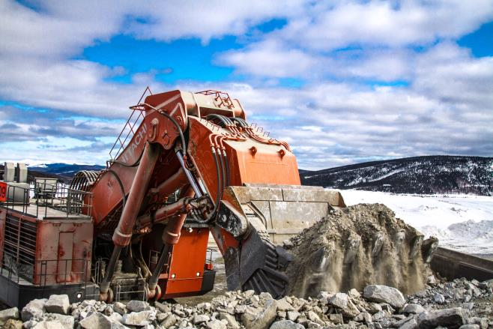
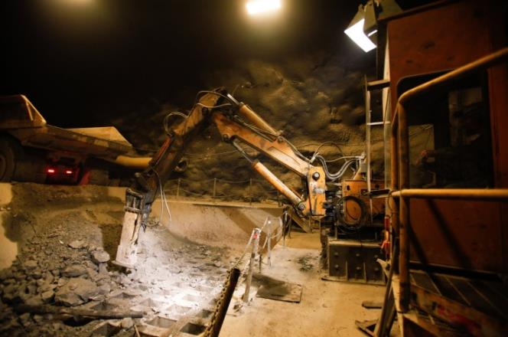
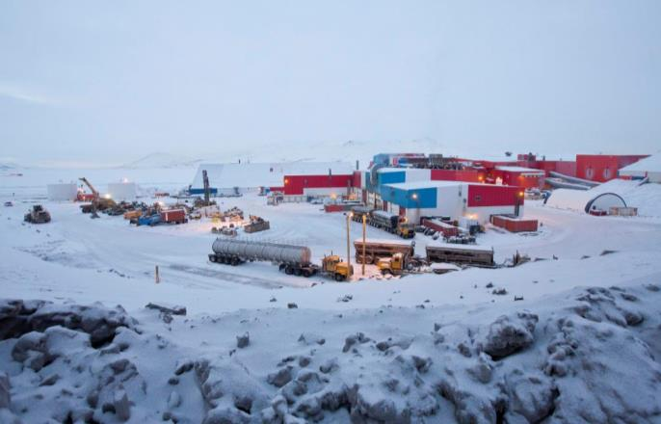
Mining Pays its Way
Companies pay exploration, development and construction costs
This often includes access and infrastructure, unlike in Lower 48
Financial assurance for reclamation and closure
Notes:
Companies pay exploration, development and construction costs (these pre-production costs are not deductible on net income, except through depreciation) – modern mining, technologically advanced
Access and infrastructure: must go where the deposits are located, often remote: Red Dog, Kensington supply own power; Pogo built a 50 mile road and electrical transmission line; Greens Creek and Kensington built ports; Donlin is looking at building a 315 mile natural gas pipeline. It is clear that if our deposits were in Nevada, they would probably already be operating mines. Because they would be close to roads and rail and able to just plug into the existing electrical grid. Meanwhile, here in Alaska, the infrastructure parts of mine development are mega projects in themselves. With all of the cost and regulatory timelines that come with a mega project.
RSA – over the last fiveyears, fluctuates between $1 million and $2 million. $2.2 million in 2013 because Donlin had started permitting. $1 million in 2017. This number will likely go up now with Pebble in permitting and A
Reclamation and Closure

Slide 22
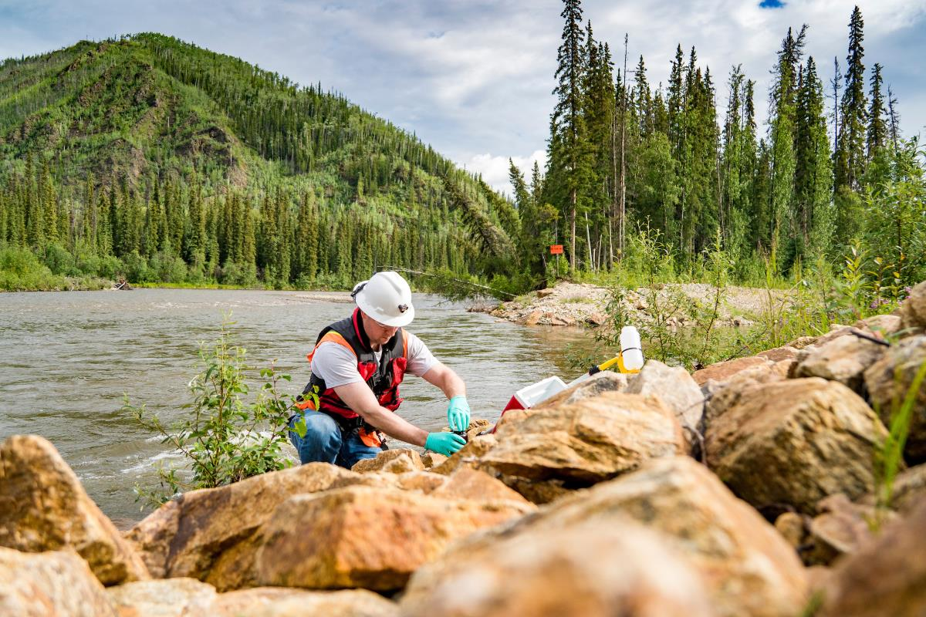
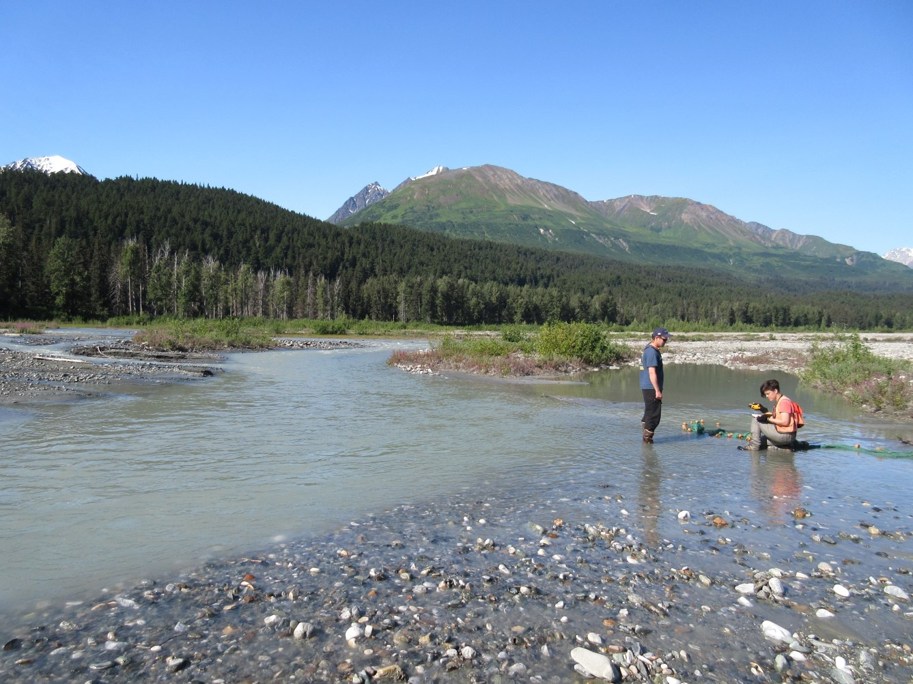
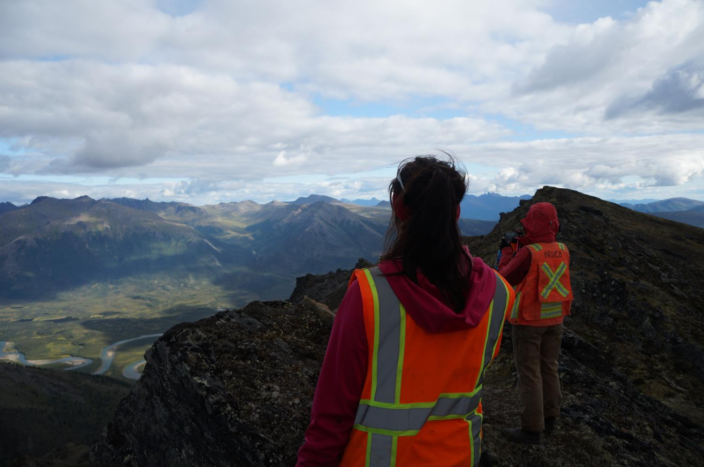
Mining Pays its Way: Reimbursable Service Agreements
 | 2012 | 2013 | 2014 | 2015 | 2016 | 2017
OPMP* receipts | 2,600,000 | 2,200,000 | 1,900,000 | 1,700,000 | 1,400,000 | 1,000,000
*The ADNR Office of Project Management and Permitting (OPMP) recovers costs from applicants for large mine permit coordination, per AS 38.05.020(b)(9) and AS 37.05.146(b)(3).
Source: ADNR: Alaska Mineral Industry Report 2017

Slide 23
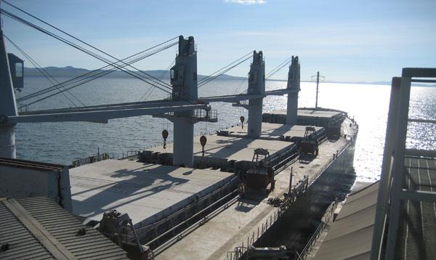
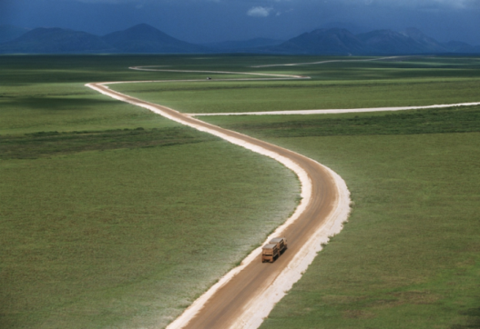
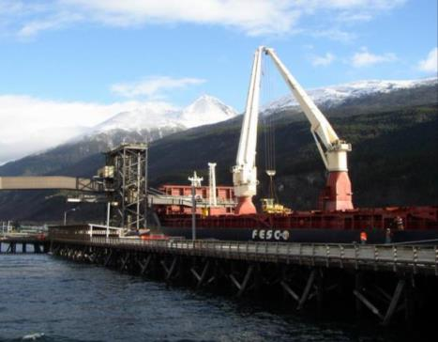
AIDEA’S Return on Investment
Mission: encourage Alaska’s economic growth
$265 million investment in the Red Dog port and road
$465 million in payments from Red Dog (12/2017)
6.5% annual interest on loan agreement
Annual dividend to State General Fund
Contract goes to 2040
Source: www.aidea.org and AIDEA email 2018-02-08
Notes:
So let’s look at AIDEA and their investment in the Red Dog port and road. AIDEA’s mandate is to make good investments but also to stimulate economic growth. By all measures, this investment has been one of AIDEA’s most successful. The full investment was $265 million, AIDEA has received $439 million to date and the contract has an annual interest rate of 6.5%. Most importantly, it helped make Red Dog possible. This is a mine that has brought more than $1 billion in net proceeds to NANA and the other ANCSA corporations, provided jobs and contracting opportunities since the 1980s and contributed to state and local government revenue.
Total amount AIDEA has received from Red Dog: $438,782,000 thru 12/31/2016, which paid for debt service, management costs, and contributions to the reserve account.
AIDEA owns the DMTS, and recovers its costs and return on its investment through annual lease payments from Teck for the road and the port complex. The lease includes minimum annual payments and supplemental payments based on tonnage shipped, and a share of the upside when zinc prices are high. Based on current ore throughput projections, we expect that a portion of the lease will be repaid early (in 2023). However, because AIDEA continues to own DMTS, Teck will continue to pay a tolling arrangement that changes to a flat tonnage fee with no minimum payments and no supplemental fees, through 2040.
The Alaska Mineral Industry report of $11 million in AIDEA faciility user fees is based on the net revenue from the fees (tolls/rent) from both DMTS ($10,852,000) and Skagway ($504,000).
The Ambler study and permitting is appropriate due diligence to see if it is a good investment for AIDEA and encourage economic growth for the region.

Slide 24
Exploration Spending Turns Around
Exploration spending ($ millions)*
ADNR Alaska Mineral Industry reports
2018: Economic Benefits of Alaska’s Mining Industry, The McDowell Group, Inc. March 2019
Notes:
Unfortunately, the last few years has seen fewer investment dollars for exploration and greater competition for those dollars.
Explain slide.
Good news, McDowell Group estimates 2016 exploration spending in Alaska was $67 million, a small increase from the $58 million in 2015. Small but moving in the right direction.

Slide 25
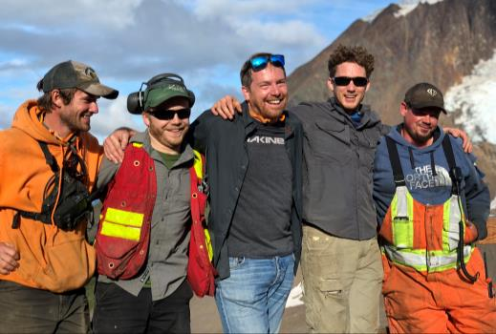
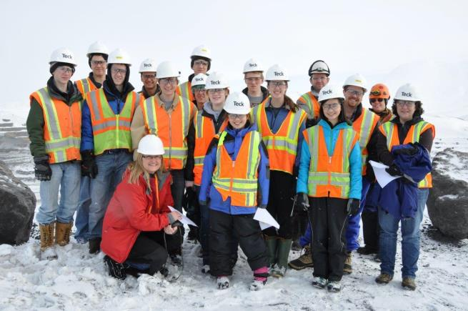
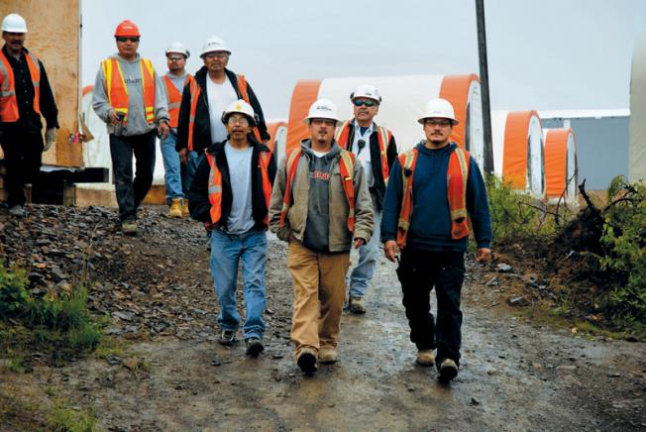
Let’s Attract Investment to Alaska
Bring more mines into production, especially those on state land
Keep Alaska competitive with other mining jurisdictions
Keep the permitting process rigorous and efficient
Preserve a stable and predictable tax structure at the state and local level
Notes:
There will always be a need for metals in the global economy
But AK has to compete for global investment.
AK challenges: infrastructure, climate, distance from market;, one of the few elements the state can control is the perception of positive investment climate, we need to send a message that AK is open for business
Because The limited capital will go to jurisdictions that encourage mineral development. I hope that AK will be one of those jurisdictions.
So we need policies that attract that investment so we can have new mines making greater contribution through jobs, state and local revenue, opportunities for AK businesses, etc.
Many Alaska communities and thousands of Alaska miners and their families depend on a healthy mining industry.

Slide 26
Thank you!
Deantha Crockett
Executive Director
Alaska Miners Association
deantha@alaskaminers.org
(907) 317-6323
Karen Matthias
Executive Director
Council of Alaska Producers
kjmatthias@alaskaproducers.org
(907) 301-1022

